Slide 1
Topic: Percentage change EQ: How Do I Calculate a Percentage of An Amount?
Year 8 Mathematics

Slide 2
Five Questions (LHS)
Date: XX/XX/2021
In a class of 30 students there are 20 students who like Maths, 15 who like English and 12 who like science, represent this as a ratio.
Create 2 different examples of rates.
Find the mode & range of the following numbers (45, 20, 41, 38, 42, 42, 48, 55)
Find the mean of the following numbers (2, 7, 4, 8, 9, 10)
Have you updated last weeks summaries, if not, do so now!

Slide 3
24
7
30
Topic: Financial Maths
Date: XX/XX/2021
EQ – How do I work out the percentage of an amount?
Question
Example
Example
How do I calculate the percentage of a number?
35% of 80
40% of 60
35 x 80
100
40 x 60
100
0.35 x 80 = 28
0.4 x 60 = 24

Slide 4
24
7
30
Financial Maths
Date: XX/XX/2021
EQ – How do I work out the percentage of an amount?
Practice questions
Answers
$12
$30
$32

Slide 5
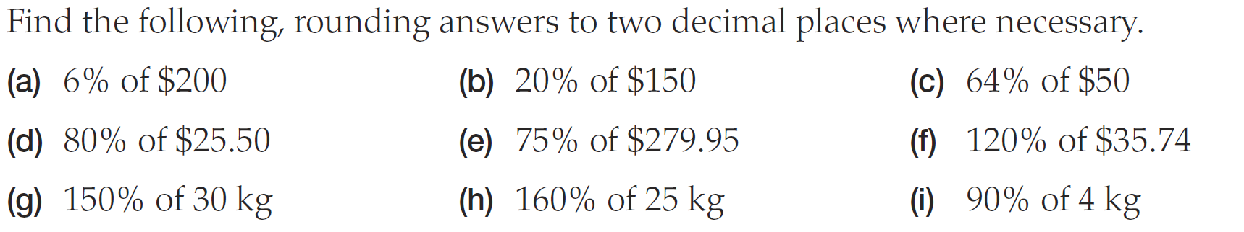
Practice (continue from Question d)
Answers
A 12 B 30 C 32
D 20.4 E 209.96 F 42.89
G 45 H 40 I 3.6

Slide 6
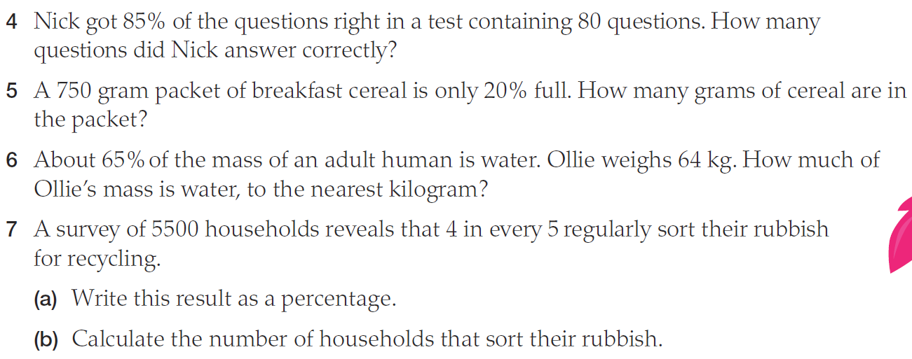
Worded Questions

Slide 7
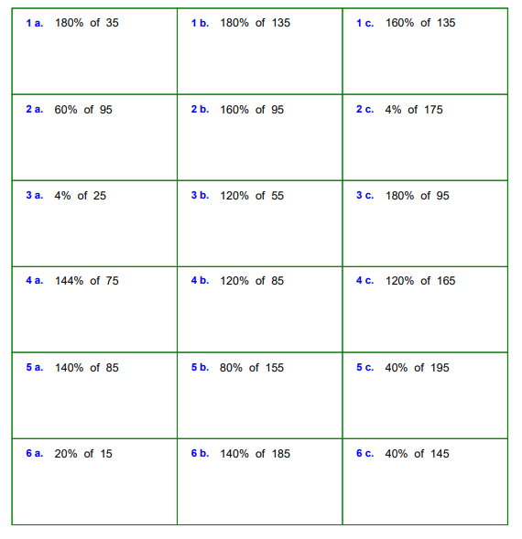
Additional questions
Question workings

Slide 8
Percentage Bingo
Aim: Full House
Grid: 9 Grid
Play: Calculate answer & cross it off

Slide 9
Use any of these numbers in your grid (NO REPEATS)
24 12 25 63
49 48 15 36
21 54 30 16
9 10 55 33

Slide 10
Question
5% of 1080

Slide 11
Question
30% of 40

Slide 12
Question
5% of 180

Slide 13
Question
90% of 40

Slide 14
Question
20% of 120

Slide 15
Question
12.5% of 200

Slide 16
Question
50% of 60

Slide 17
Question
110% of 50

Slide 18
Question
30% of 210

Slide 19
Question
150% of 10

Slide 20
Question
40% of 120

Slide 21
Question
70% of 70

Slide 22
Question
125% of 8

Slide 23
Question
10% of 160

Slide 24
Question
11% of 300

Slide 25
Question
30% of 70

